Slide 1






GO Lang !!!
Training
Mahasak Pijittum
Programming language by

Slide 2

Course Outline
Opening & Introduction to Go
Basic Language Syntax
Methods, Interfaces and Embedding
Concurrency and Channels
Next ?!?!
Red -> Exists in workshop only !!!

Slide 3
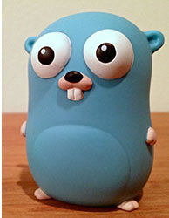
GO is :
Open source
Concurrent
Garbage-collected
Efficient
Scalable
Simple
Fun
Boring (to some)

Slide 4
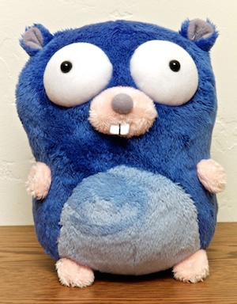
GO is :
Comes with a robust standard library.
Works on a multitude of platforms.
Code is statically compiled so deployment is trivial.
Comes with a complete set of documentation.
Comes with a tool to test, profile and benchmarks your code.
Can interact with C libraries via cgo

Slide 5

Notes:
Kenneth Thompson & Dennis Ritchie

Slide 6
Official Documentation
Official Website
  http://golang.org/
Official Documentation
  http://golang.org/doc
Effective Go
  http://golang.org/doc/effective_go.html
Packages
  http://golang.org/pkg
How to write go
  http://golang.org/doc/code.html

Slide 7
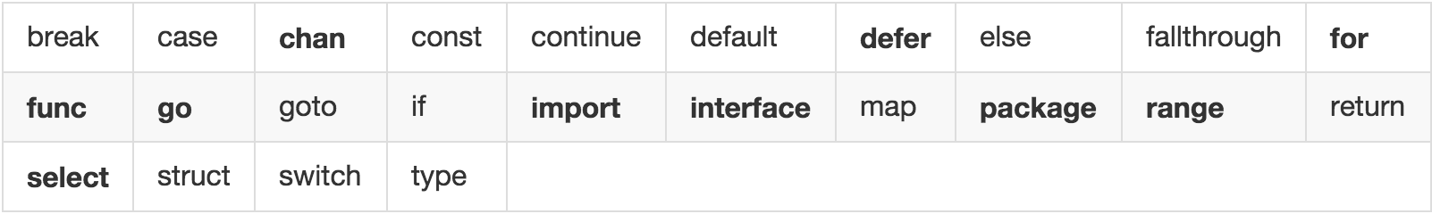
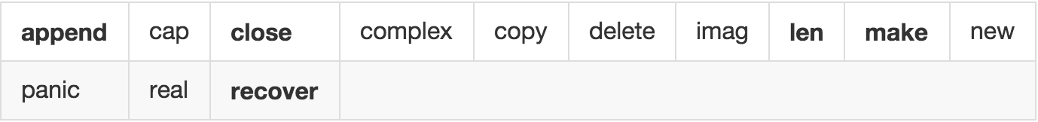
Keywords
Built-in Function

Slide 8
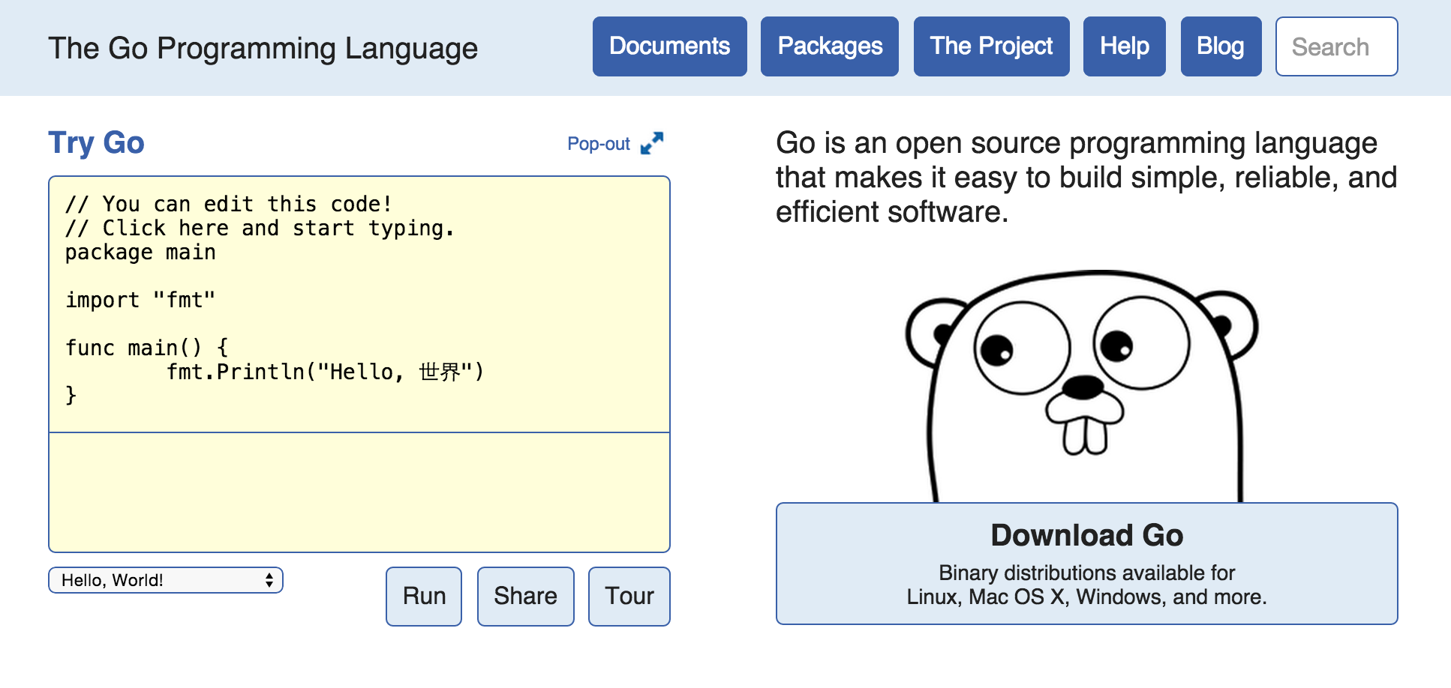
Installation
Get Go binary from https://golang.org/

Slide 9
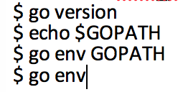
Installation
Extract Go binary to your computer
Set environment variable GOROOT and GOPATH
  Windows set in Environment Variables
  OSX/Linux set in ~/.bash_profile & source ~/.bash_profile
Set environment PATH with GOROOT and GOPATH
Test with command line

Slide 10
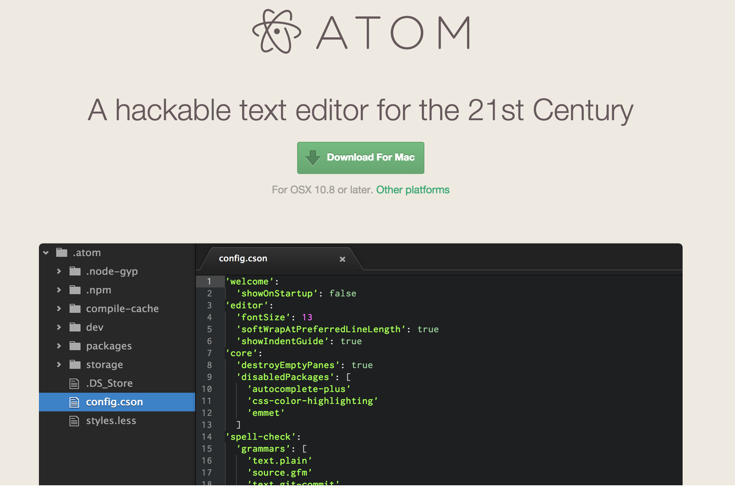
IDE
Get Atom from https://atom.io/ and install, It’s availabel for OS X, Windows and Linux
Open Atom and go to Preference > Packages , search for go-plus , and install it

Slide 11
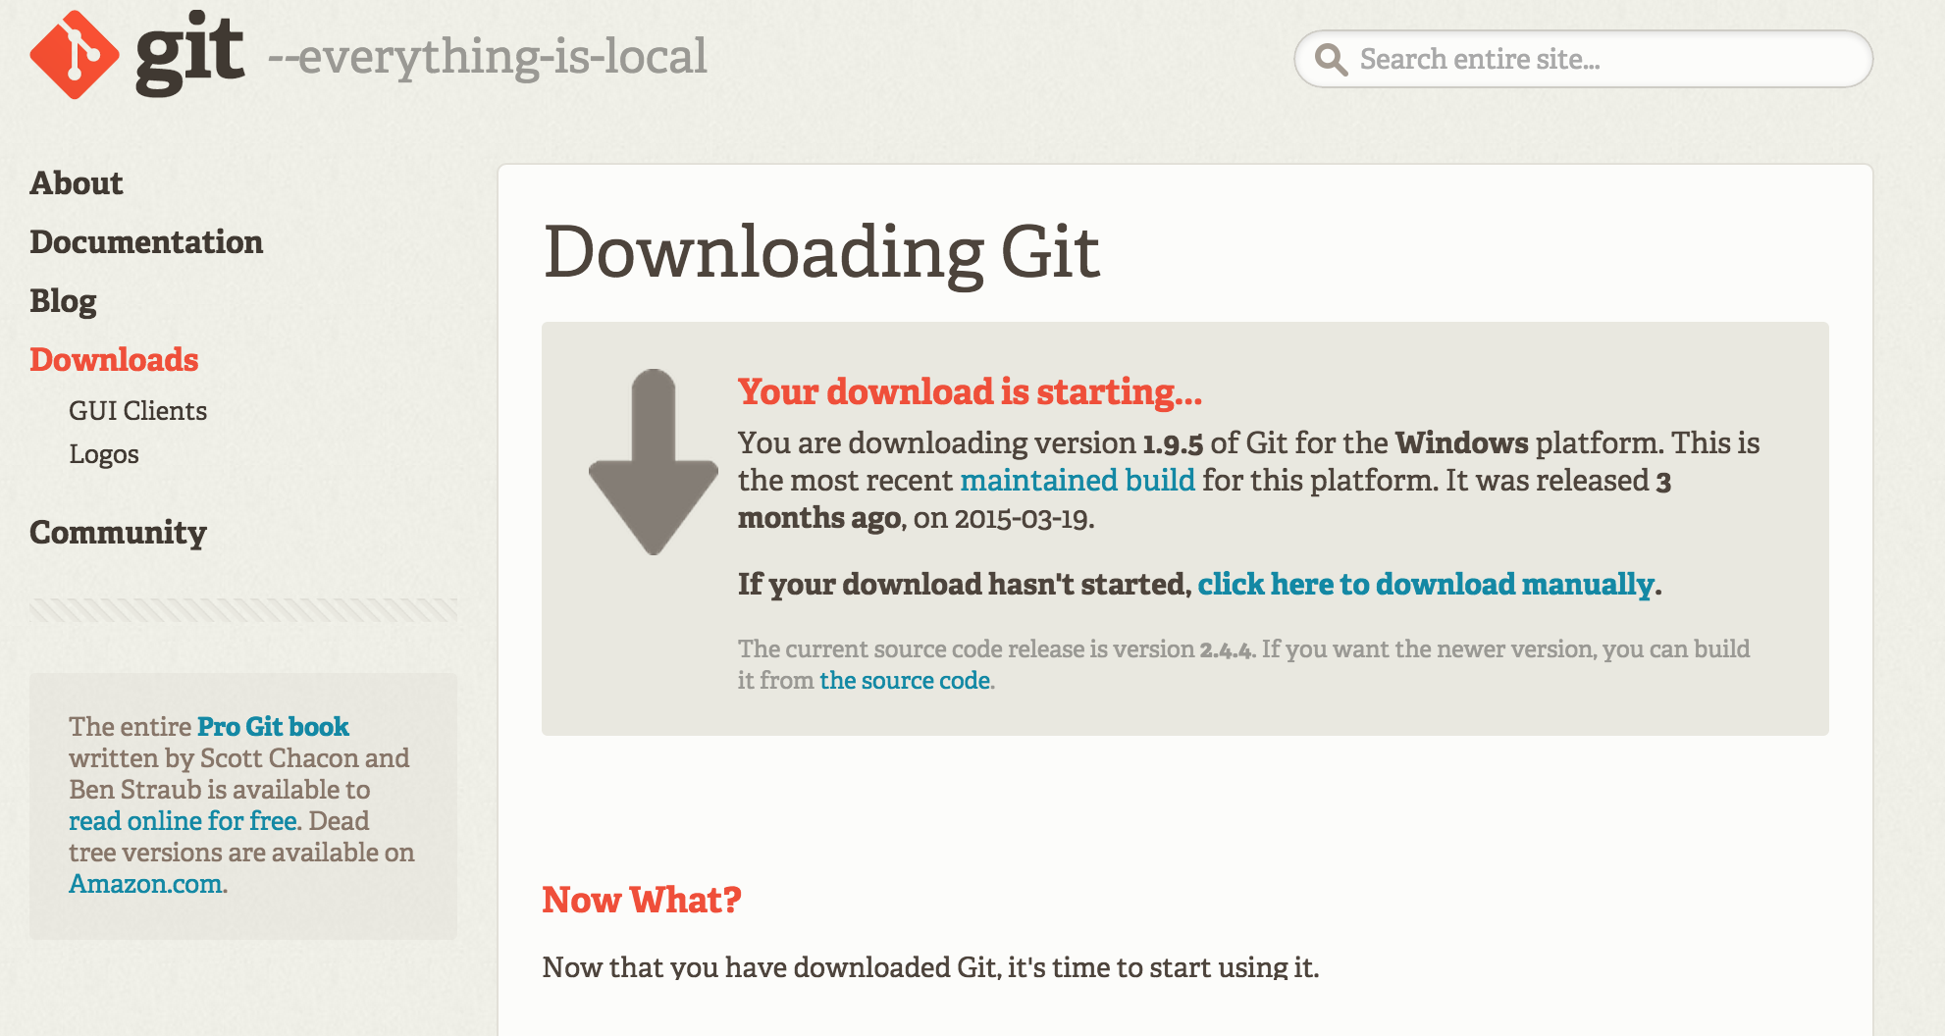
Tools
Get Git for your OS
  Windows
    https://git-scm.com/download/win
  OSX & Linux … You’ve know how to get it

Slide 12
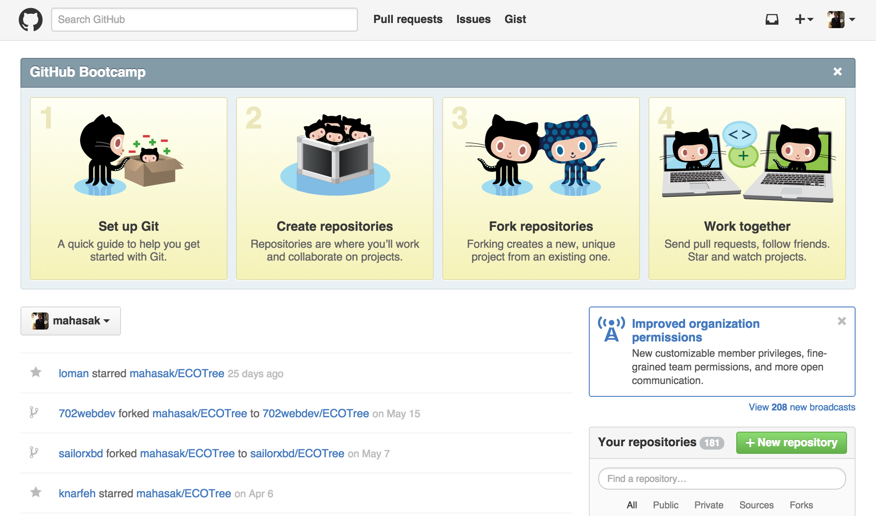
Repository
Create github account for yourself
  https://github.com/

Slide 13

Hello Gopher !!!
Hello world
  http://play.golang.org/p/c7pWIACQdw

Slide 14
Hello Gopher !!!
import "fmt"
func main() {
fmt.Println("Hello gopher !!!")
}

Slide 15
Hello Gopher !!!
import "fmt"
func main() {
var hello string = "test”
fmt.Println("Hello gopher !!!")
}
Notes:
จะ error
at line 6, file hello.go
hello declared and not used

Slide 16
Hello Gopher !!!
import "fmt"
func main() {
var hello string = "test”
fmt.Println("Hello gopher !!!" + test)
}
Notes:
จะ error
at line 6, file hello.go
hello declared and not used

Slide 17
Hello Gopher !!!
var hello string = "test"
var --> Keyword
hello --> Variable name
string --> Type
var hello string = test”
var hello = "test”
hello := "test"
Zero value ของ Go ขึ้นอยู่กับ Type ของ VAR
Notes:
จะ error
at line 6, file hello.go
hello declared and not used

Slide 18
Hello Gopher !!!
var hello byte
var hello int
var hello bool
var hello int64
var hello float64
Notes:
จะ error
at line 6, file hello.go
hello declared and not used

Slide 19
Type Casting!!!
package main
import "fmt"
func main() {
hello := "hello gother!!!"
fmt.Println([]byte(hello))
}
Notes:
จะ error
at line 6, file hello.go
hello declared and not used

Slide 20
Type Casting!!!
package main
import "fmt"
func main() {
hello := "hello gother!!!"
var a int = 3
var f float32 = a
fmt.Println([]byte(hello))
}
Notes:
จะ error
at line 6, file hello.go
hello declared and not used

Slide 21
Type Casting!!!
package main
import "fmt"
func main() {
hello := "hello gother!!!"
var a int = 3
var f float32 = float32(a)
fmt.Println([]byte(hello))
}
Notes:
จะ error
at line 6, file hello.go
hello declared and not used

Slide 22
Array !!!
package main
import "fmt"
func main() {
  var arr = [6]int{1, 2, 3, 4, 5, 6}
  fmt.Println(arr)
}
Notes:
จะ error
at line 6, file hello.go
hello declared and not used

Slide 23
Array !!!
package main
import "fmt"
func main() {
var arr = [6]int{1, 2, 3, 4, 5}
fmt.Println(arr)
}
Notes:
จะ error
at line 6, file hello.go
hello declared and not used

Slide 24
Slices !!!
package main
import "fmt"
func main() {
var arr = []int{1, 2, 3, 4, 5}
fmt.Println(arr)
}
Notes:
จะ error
at line 6, file hello.go
hello declared and not used

Slide 25
Slices !!!
package main
import "fmt"
func main() {
var arr = []int{1, 2, 3, 4, 5}
fmt.Println(arr[0:2])
}
Notes:
จะ error
at line 6, file hello.go
hello declared and not used

Slide 26
Slices !!!
package main
import "fmt"
func main() {
var slice = []int{1, 2, 3, 4, 5}
slice = append(slice, 7)
fmt.Println(slice)
}
Notes:
จะ error
at line 6, file hello.go
hello declared and not used

Slide 27
Slices !!!
package main
import "fmt"
func main() {
var slice = []int{1, 2, 3, 4, 5}
slice = append(slice, 7)
slice2 :=append([]int{7,8,9,10,10}, slice...)
fmt.Println(slice)
}
Notes:
จะ error
at line 6, file hello.go
hello declared and not used

Slide 28
Map !!!
var m =map[string]int
string --> type of key
int --> type of value
Notes:
จะ error
at line 6, file hello.go
hello declared and not used

Slide 29
Map !!!
package main
import "fmt"
func main() {
var m = map[string]int{
"hello": 1,
"haha": 2,
"world": 3,
"test": 4,
}
fmt.Println(m["world"])
}
Notes:
จะ error
at line 6, file hello.go
hello declared and not used

Slide 30
Map !!!
package main
import "fmt"
func main() {
var m = map[string]int{
"hello": 1,
"haha": 2,
"world": 3,
"test": 4,
}
    fmt.Println(m)
    fmt.Println(m["world"])
    delete(m, "test")
    fmt.Println(m)
    m["test2"] = 3
    fmt.Println(m)
}
Notes:
จะ error
at line 6, file hello.go
hello declared and not used

Slide 31
Loops!!!
package main
import "fmt"
func main() {
for i := 0; i < 10; i++ {
fmt.Println(i)
}
o := 0
for o < 10 {
fmt.Println(o)
o++
}
}
Notes:
จะ error
at line 6, file hello.go
hello declared and not used

Slide 32
Loops!!!
package main
import "fmt"
func main() {
c := 0
for {
if c == 5000 {
break
}
fmt.Println(c)
c++
}
}
Notes:
จะ error
at line 6, file hello.go
hello declared and not used

Slide 33
Loops a slices!!!
package main
import "fmt"
func main() {
  slice := []int{10, 20, 30, 40}
  for i := 0; i < len(slice); i++ {
    fmt.Println(slice[i])
  }
}
Notes:
จะ error
at line 6, file hello.go
hello declared and not used

Slide 34
For … Range!!!
package main
import "fmt"
func main() {
  slice := []int{10, 20, 30, 40}
  for _, value := range slice {
  fmt.Println(value)
  }
}
Notes:
จะ error
at line 6, file hello.go
hello declared and not used

Slide 35
For … Range!!!
package main
import "fmt"
func main() {
  slice := []int{10, 20, 30, 40}
  for key, value := range slice {
  fmt.Println(key, value)
  }
}
Notes:
จะ error
at line 6, file hello.go
hello declared and not used

Slide 36
Switch!!!
package main
import "fmt"
func main() {
  n := 20
  switch n {
  case 10:
  fmt.Println("hello")
  case 20:
  fmt.Println("world")
  }
}
Notes:
จะ error
at line 6, file hello.go
hello declared and not used

Slide 37
Switch Group!!!
package main
import "fmt"
func main() {
n := 20
  switch {
  case n < 10:
  fmt.Println("hello")
  case n > 10:
  fmt.Println("world")
  }
}
Notes:
จะ error
at line 6, file hello.go
hello declared and not used

Slide 38
Switch Group!!!
package main
import "fmt"
func main() {
n := 20
  switch {
  case n < 10:
  fmt.Println("hello")
  case n > 10:
  fmt.Println("world")
  }
}
Notes:
จะ error
at line 6, file hello.go
hello declared and not used

Slide 39
Function!!!
package main
import "fmt"
func main() {
  n1 := 2
  n2 := 3
  fmt.Println(add(n1, n2))
}
func add(n1 int, n2 int) int {
return n1 + n2
}
Notes:
จะ error
at line 6, file hello.go
hello declared and not used

Slide 40
Multiple Return!!!
package main
import "fmt"
func main() {
var result int
var ret int
result, ret = add(10, 20)
fmt.Println(result, ret)
}
func add(n1 int, n2 int) (int, int) {
return n1 + n2, 0
}
Notes:
จะ error
at line 6, file hello.go
hello declared and not used

Slide 41
Package!!!
package contact
import "fmt"
// Save creates contact
func Save(name string, tel string, email string) {
  fmt.Println(name, tel, email)
}
Method ที่จะ export ให้โปรแกรมภายนอก package ใช้งาน ต้องขึ้นต้นด้วยตัวใหญ่
Notes:
จะ error
at line 6, file hello.go
hello declared and not used

Slide 42
Package level variables!!!
package contact
import "fmt"
//Contact Data Type
type Contact struct {
Tel string
Email string
}
var contacts = make(map[string]Contact)
var contacts = map[string]Contact{}
// Save creates contact
func Save(name string, c Contact) {
fmt.Println(name, c.Tel, c.Email)
}
Method ที่จะ export ให้โปรแกรมภายนอก package ใช้งาน ต้องขึ้นต้นด้วยตัวใหญ่
Notes:
จะ error
at line 6, file hello.go
hello declared and not used

Slide 43
Package!!!
package contact
import "fmt"
//Contact Data Type
type Contact struct {
  Tel string
  Email string
}
var contacts = make(map[string]Contact)
// Save creates contact
func Save(name string, c Contact) {
  contacts[name] = c
  fmt.Println(contacts)
}
// Get a contact
func Get(name string) (Contact, bool) {
  v, found := contacts[name]
  return v, found
}
Notes:
จะ error
at line 6, file hello.go
hello declared and not used

Slide 44
Package!!!
package contact
import "fmt"
//Contact Data Type
type Contact struct {
  Tel string
  Email string
}
var contacts = make(map[string]Contact)
// Save creates contact
func Save(name string, c Contact) {
  contacts[name] = c
  fmt.Println(contacts)
}
// Get a contact
func Get(name string) (c Contact, found bool) {
  c, found = contacts[name]
  return
}
Notes:
จะ error
at line 6, file hello.go
hello declared and not used

Slide 45
GO Lang !!!
Workshop
Mahasak Pijittum
Programming language by

